Slide 1

CARDIO VASCULAR analysis using machine learning
BY
AMIT SUBEDI

Slide 2
INTRODUCTION
The coronary arteries in the heart are responsible for the supply of oxygen to the heart muscle. The weakness of the valves leading to the closure of a coronary artery, which reduces the amount of blood entering the heart. This is a portion of the myocardium is interrupted due to a lack of blood [1]. If there is not enough blood flow and its not fixed in time, it will lead to the death of a person. This condition is referred to as a myocardial infarction. An arterial occlusion that can affect the normal functioning of the heart, it is called a heart attack. A heart attack is an indirect sign of a heart attack, and, therefore, is called a silent heart attack. The Records show that 72% of people who die as a result of a calm heart. The early detection of MI (myocardium infarction) is important in today's world, in order to ensure the proper handling, and to save the lives of other people. It will be located in the anterior, lateral, posterior, or the lower part of the left ventricle. They can be detected by electrocardiography (ECG). This is one of the easiest and most widely used technology. An ECG records the electrical performance of the heart, in the form of signals.

Slide 3
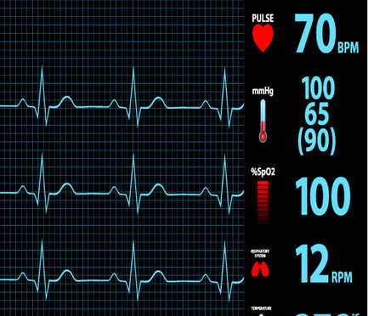
Software Requirements: LANGUAGE USED: Python, Anaconda(Jupyter Notebook) TOOLS: Visual Studio Code, Python, Anaconda PLATFORM: Windows 7 & above BROWSER USED: Google Chrome.
Hardware Requirements:
PROCESSOR: Dual core or Higher
SPEED: 2.93GHz
PRIMARY MEMORY: 1 GB RAM
HARD DISK: 4GB

Slide 4
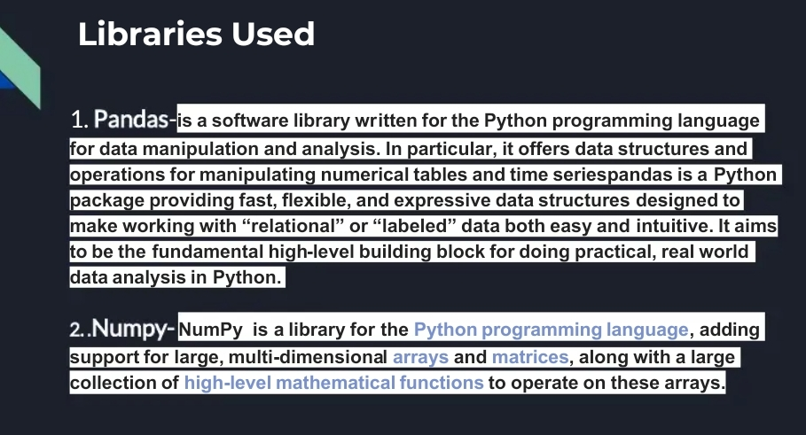

Slide 5


Slide 6


Slide 7
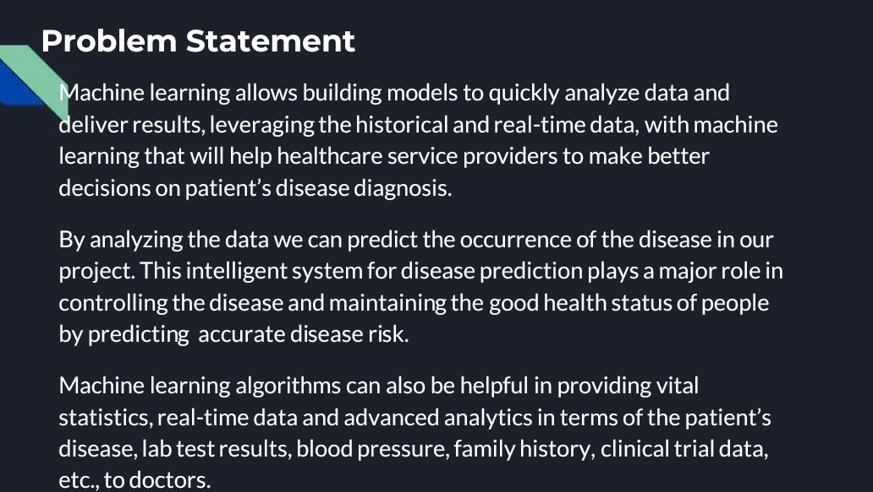

Slide 8
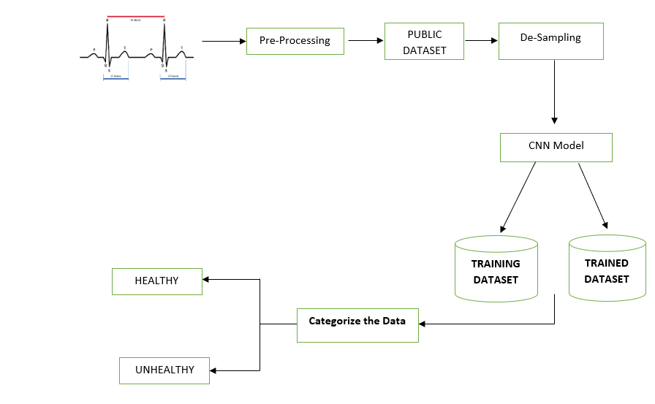
PROPOSED ARCHITECTURE

Slide 9
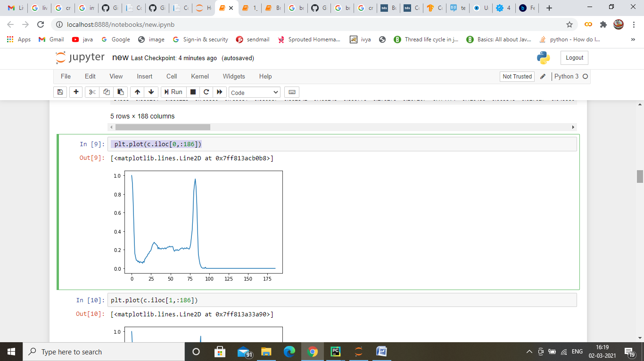
JUPYTER ENVIRONMENT

Slide 10
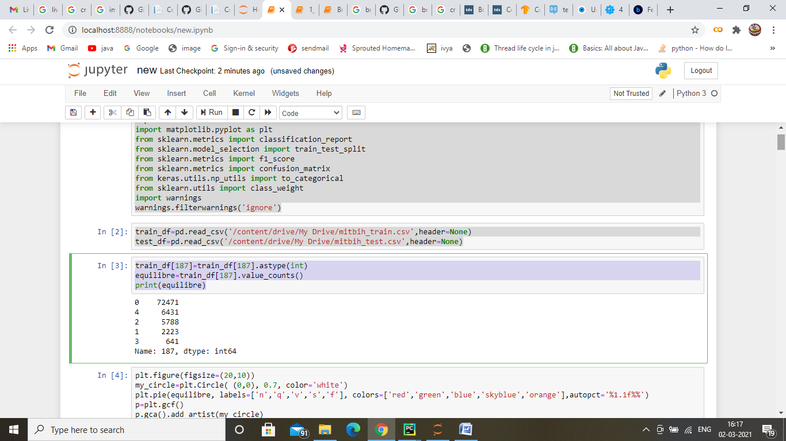
EXPERIMENTAL RESULTS

Slide 11
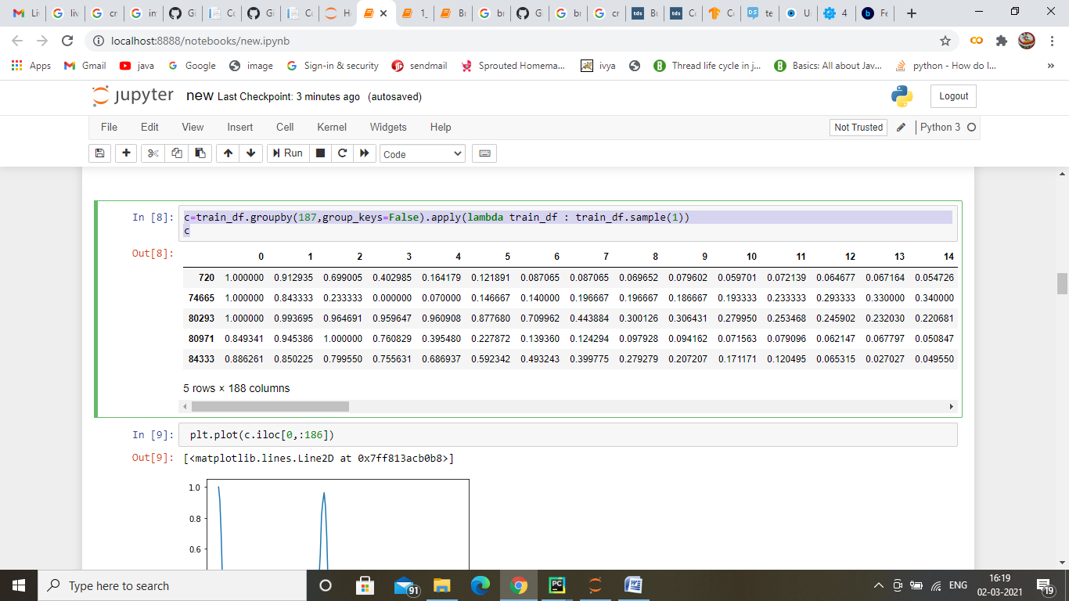
PLOTTING BASED ON ECG VALUES

Slide 12
FEATURED EXTRACTION AND ANALYSIS USING CNN
CNN Algorithm (Recordings) | False Positive | False Negative
30 | 11 | 14
100 | 15 | 19

Slide 13
CONCLUSION AND FUTURE SCOPE
we propose machine learning based technique to predict heart diseases at the early stage. In this paper, we have used public repository dataset of 100+ recordings from 100+ different patients for data analysis. We have used CNN for classification. Based on the features and conditions, the trained model is been generated. This proposed methodology renders promising results. For experimental results we have used python and Jupyter tool for data analysis and prediction.

